Slide 1


Tutorial Week 4
EE469/EE669/EE869/EE969
Module Introduction
carmine.clemente@strath.ac.uk

Slide 2
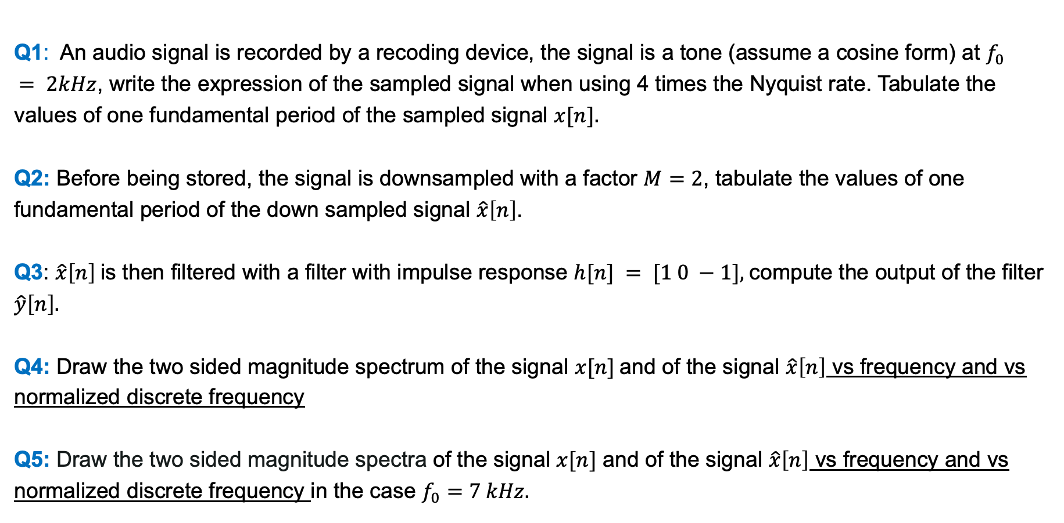
Question
Q1: An audio signal is recorded by a recoding device, the signal is a tone (assume a cosine form) at $f_{0}$
$= 2kHz$, write the expression of the sampled signal when using 4 times the Nyquist rate. Tabulate the values of one fundamental period of the sampled signal $x[n].$
Q2: Before being stored, the signal is downsampled with a factor $M=2$, tabulate the values of one fundamental period of the down sampled signal $\hat{x}\left[n\right]$.
Q3: $\hat{x}\left[n\right]$is then filtered with a filter with impulse response $h[n] = [1 0 −1],$compute the output of the filter $\hat{y}\left[n\right].$
Q4: Draw the two sided magnitude spectrum of the signal $x[n]$and of the signal $\hat{x}\left[n\right]$ vs frequency and vs normalized discrete frequency
Q5: Draw the two sided magnitude spectra of the signal $x[n]$ and of the signal $\hat{x}\left[n\right]$ vs frequency and vs normalized discrete frequency in the case $f_{0}=7 kHz.$

Slide 3
X THE PLACE OF USEFUL LEARNING

